Slide 1
MS 601
INTRODUCTION TO MANAGEMENT

Slide 2
Definitions in Management
Organization: Two or more people who work together in a structured way to achieve a specific goal or a set of goals
Goal: the purpose that an organization strives to achieve; organizations often have more than one goal; goals are fundamental elements of organizations
Management: The process of planning, organizing, leading, and controlling the work of organization members and of using all available organizational resources to reach stated organizational goals (James A.F. Stoner)
Manager: people responsible for directing the efforts aimed at helping organizations achieve their goals

Slide 3
Management Process
Process: A systematic method of handling activities
Planning: the process of establishing goals and a suitable course of action for achieving those goals
Organizing: the process of engaging two or more people in working together in a structured way to achieve a specific goal or set of goals.
Leading: The process of directing and influencing the task-related activities of group members or an entire organization
Controlling: the process of ensuring that actual activities conform to planned activities

Slide 4
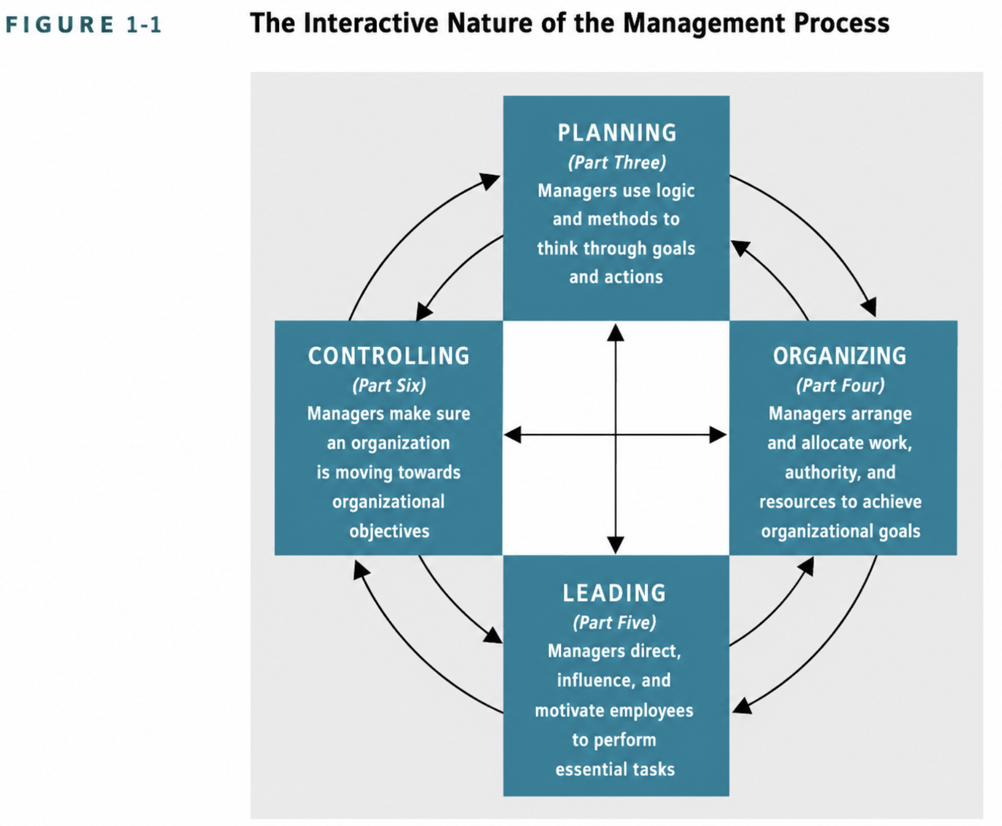

Slide 5
NATURE OF MANAGEMENT
Management aims at reaping rich results in economic terms through the rational utilization of resources, productive performance via planning and control, and maximizing profits.
Management means getting work done through people to reach a shared goal.
Management is a process, a continuous, systematic way of getting work done
Management is a universal activity required in all types of organizations (political, social, religious and educational institutions) where group efforts are needed
Management is both an art and a science because it uses structured rules and facts like a science, and personal skills and creativity like an art

Slide 6
NATURE OF MANAGEMENT
Management is considered a profession because it features specialized knowledge and formal training
Management is a goal-oriented process
Management is a group activity
Management is fundamentally a system of authority as it relies on formal hierarchy, command structures, and the legitimate right to direct resources
Management implies decision making
Management implies good leadership
Management is a dynamic function as it must adapt to the world around it to help a group or business succeed

Slide 7
Nature of Management
Management is a multidisciplinary field
Management is goal oriented
Management is needed at different levels of an organisation
There is the need of an organisation for the success of management
Management need not be owners; the separation of ownership and control
Management is an intangible force, its presence is experienced through how an organization functions, hits its targets, and maintains order

Slide 8
Purpose of Management
Reducing ambiguity in methods of working through SOPs and defined roles and responsibilities
Keeping costs down, and motivating others to do the same through resource optimization and budgetary control
Taking calculated risks through data driven analytics and cost benefit evaluation
Managing prospective risk through crisis and contingency planning and market trend forecasting
Exercise good judgement by balancing conflicting interests and evidence based decisions

Slide 9

Management Levels
First line (or first level) managers: managers who are responsible for the work of operating employees only and do not supervise other managers; they are the first or the lowest level of managers in the organizational hierarchy
Middle Managers: Managers in the midrange of the organizational hierarchy; they are responsible for other managers and sometimes for some operating employees; they also report to more senior managers
Top managers: Managers responsible for the overall management of the organization; they establish operating policies and guide the organization’s interaction with its environment

Slide 10
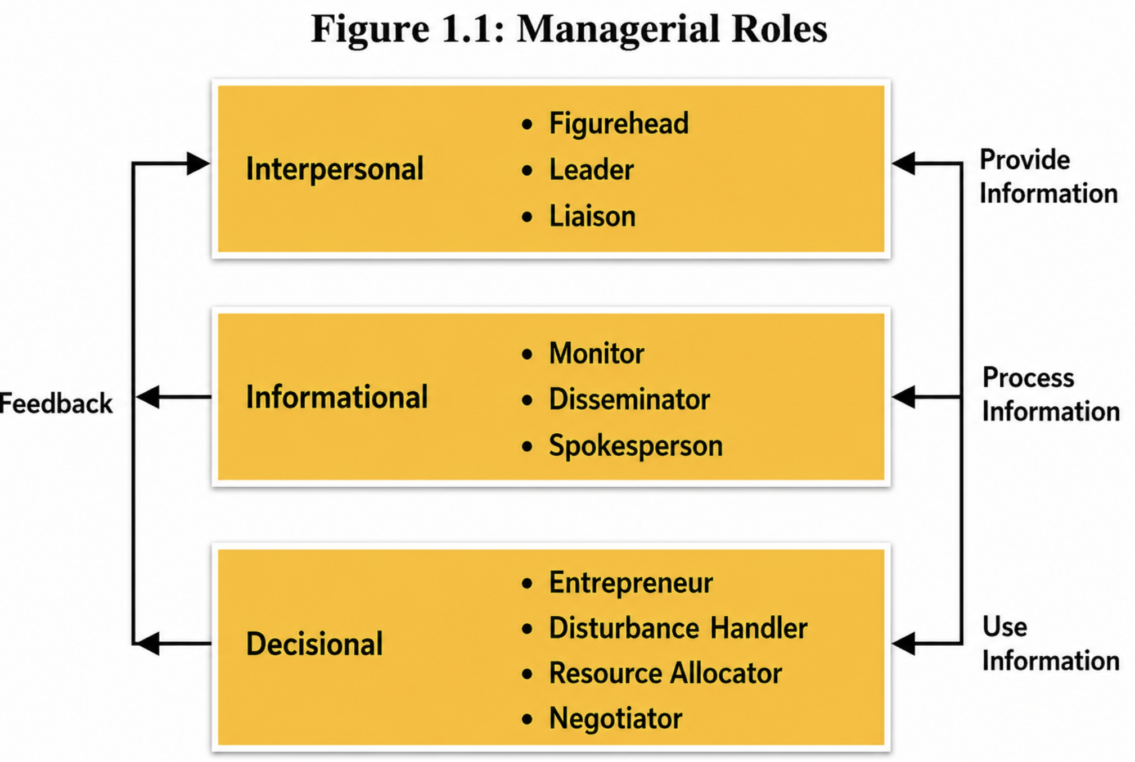
Roles of a Manager
Henry Mintzberg in the late 1960s
Interpersonal roles: help the manager keep the organisation running smoothly
figurehead role is performing duties that are ceremonial and symbolic in nature.
leadership role includes hiring, training, motivating and disciplining employees.
liaison role is serving as a connecting link between their organisation and others or between their units and other organisational units.

Slide 11
Roles of a Manager
Informational roles: receiving and communicating information are the most important aspects of a manager’s job.
monitor role: referring to information from various sources to make right decisions
disseminator role: distribute important information to subordinates

Slide 12
Roles of a Manager
Decisional roles
Entrepreneur: manager tries to improve the unit.
disturbance handlers: respond to situations that are beyond control such as strikes, shortages of materials, complaints, grievances, etc.
resource allocator: responsible for allocating human, physical and monetary resources.
Negotiators: mediate in internal conflicts and also carry out negotiations with other units

Slide 13
Skills of an Effective Manager
Robert L. Katz three types of skills
Technical skill: the ability to use the procedures, techniques, and knowledge of a specialized field (example, coding in Python, using a financial modeling software)
Human skill: the ability to work with, understand, and motivate other people as individuals or in groups (example, communication, empathy, active listening)
Conceptual skill: the ability to coordinate and integrate all of the organization’s interests and activities (example, a CEO deciding to launch a new global product)

Slide 14
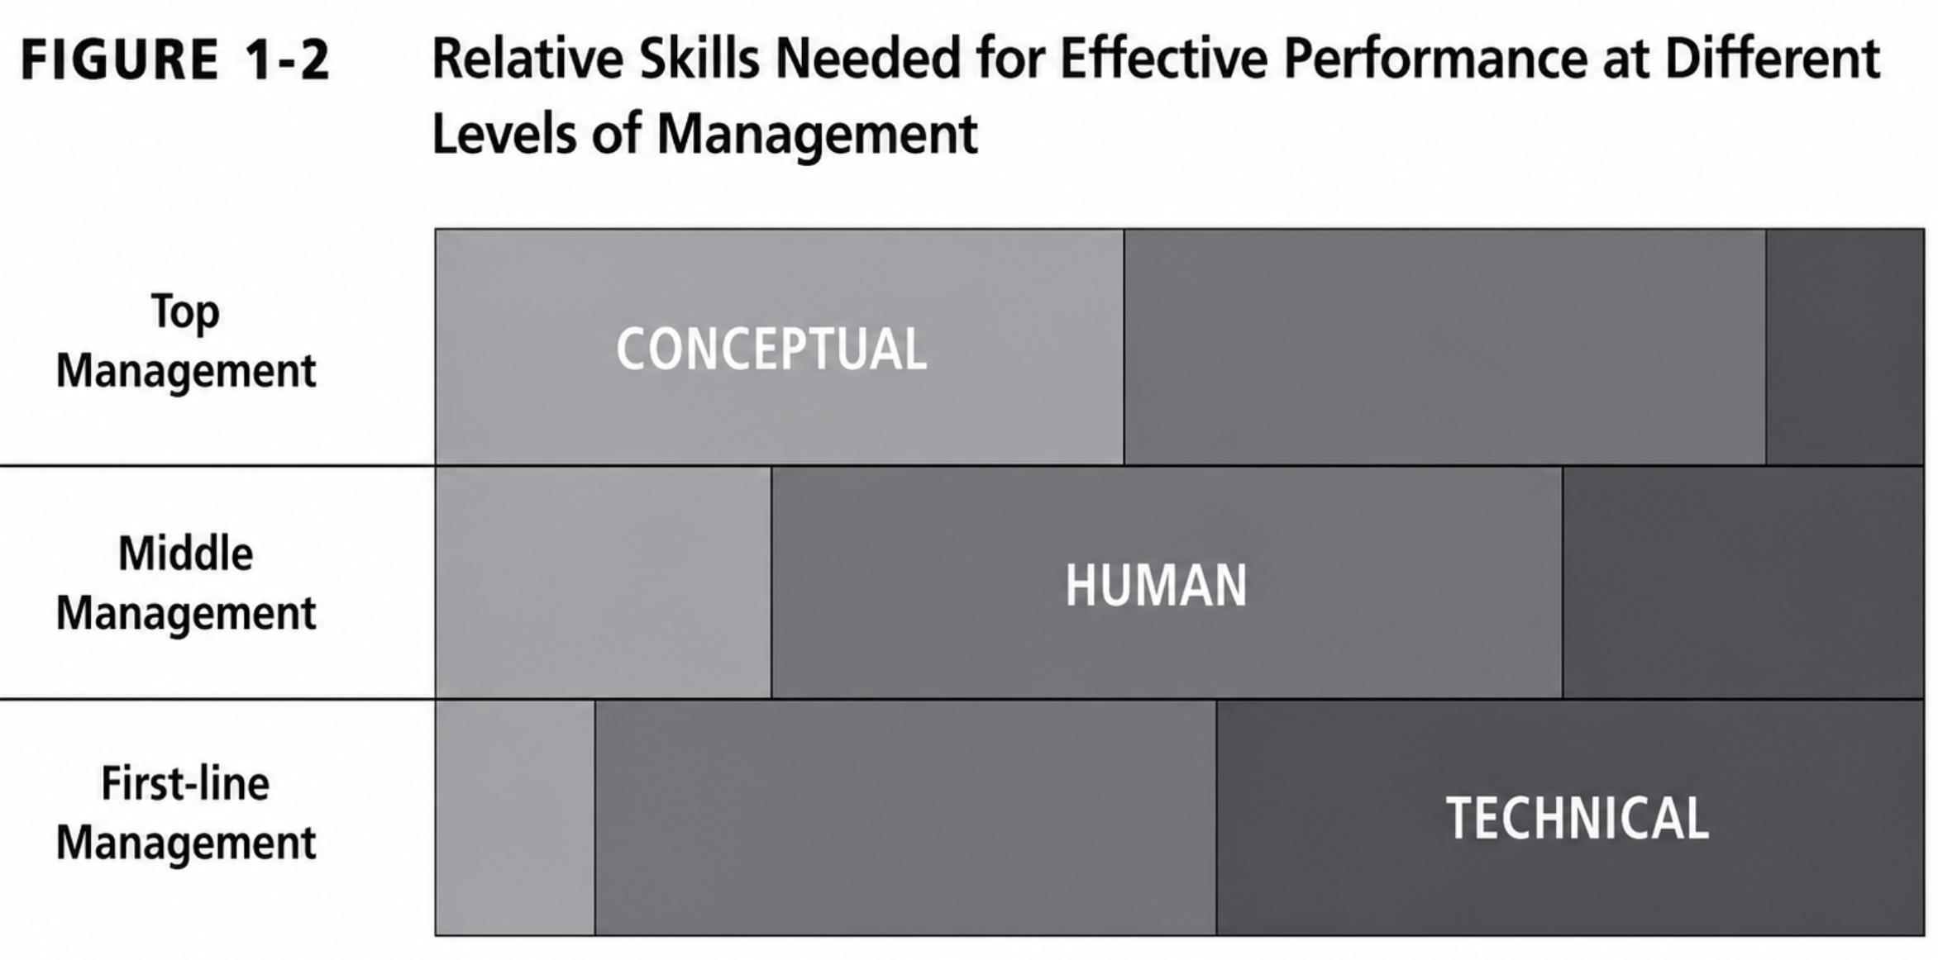

Slide 15
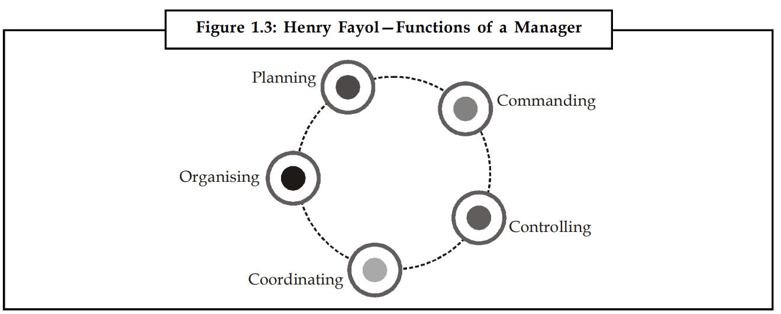
Functions of a Manager

Slide 16
Functions of a Manager
Planning: It is the process of determining enterprise objectives and selecting future courses of actions necessary for their accomplishment.
Organising: it is concerned with the arrangement of an organisation’s resources - people, materials, technology and finance in order to achieve enterprise objectives.
It involves decisions about the division of work, allocation of authority and responsibility and the coordination of tasks.
Staffing: It is defined as an activity where people are recruited, selected, trained, developed, motivated and compensated for manning various positions.

Slide 17
Functions of a Manager
Directing: The function of guiding and supervising the activities of the subordinates is known as directing.
Leadership: The success of an organisation depends upon the quality of leadership shown by its managers.
Motivation: In order to motivate employees, manager must provide a healthy, safe working environment coupled with suitable incentives.
Effective Communication
Supervision: It is seeing that subordinates do their work and do it as directed.

Slide 18
Functions of a Manager
Controlling: The objective of controlling is to ensure that actions contribute to goal accomplishment.
Setting standards of performance
Measuring actual performance
Comparing actual performance against the standard
Taking corrective actions to ensure goal accomplishment.

